Slide 1
TOD Down-Sampling
Jonah Lee

Slide 2
Possible Methods
Sampling nth value (lose information)
Windowed average
Naive average - this is what I have done at the moment
Weighted values at borders (Chapin et. al sec. 3.1.1)
FFT truncation

Slide 3
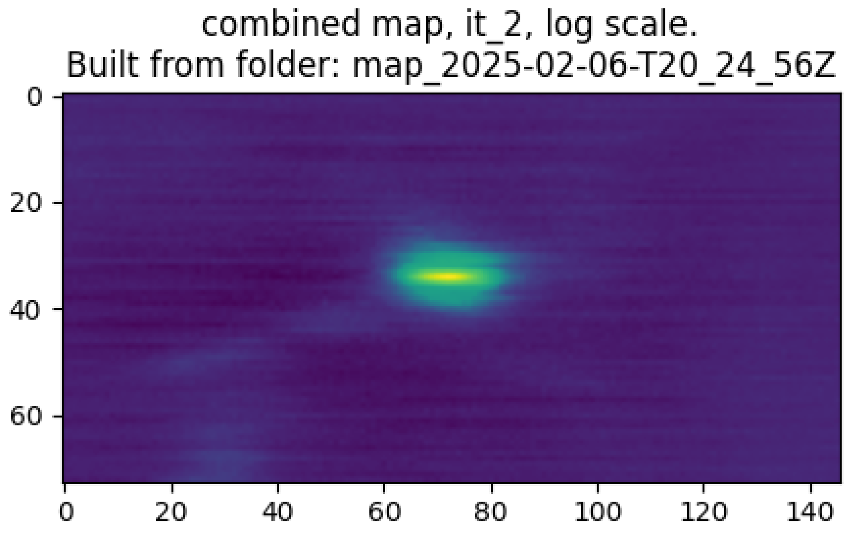

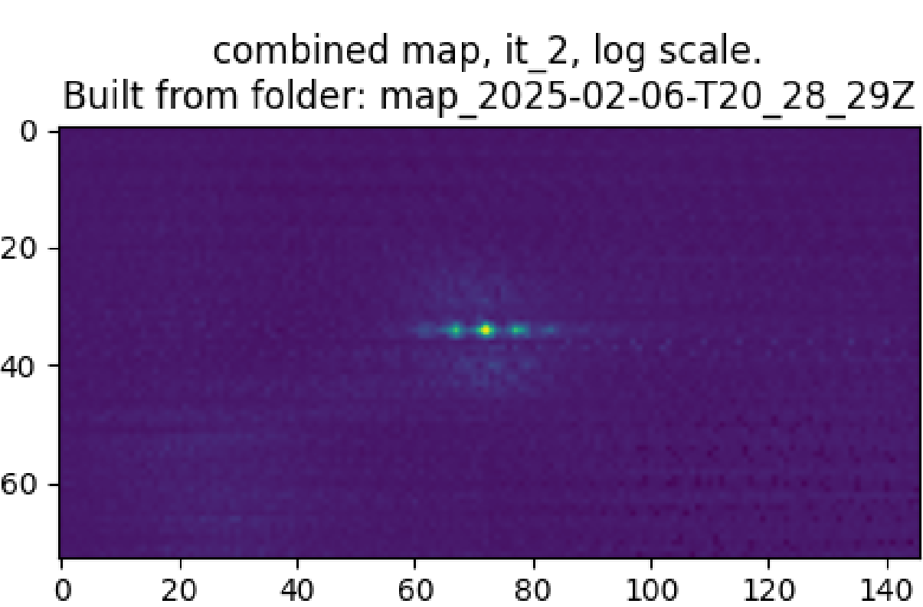
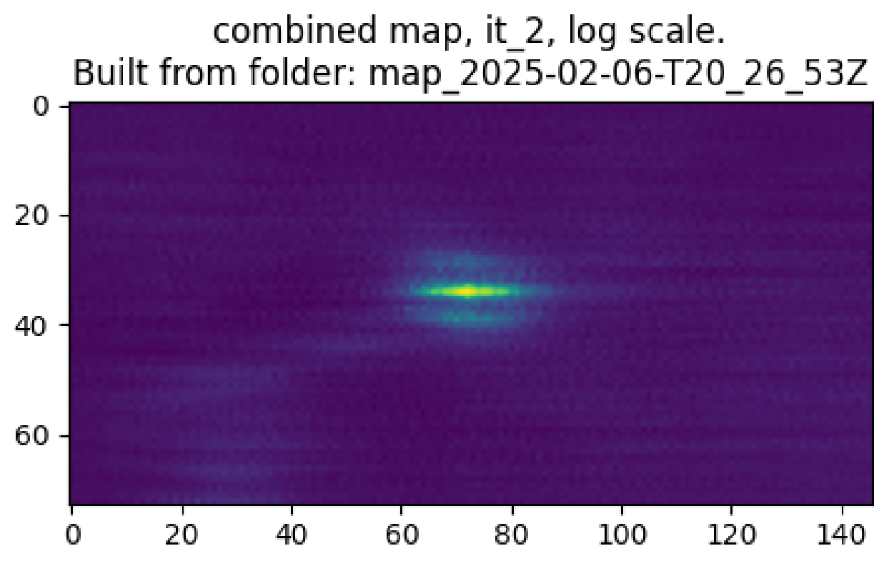
Image Differences (see speaker notes)
x10
x1
(original)
x100
x50
Notes:
According to the rule of thumb described in Chapin et al. Section 3.1.1, we get:
beam size: 54" (from config)
scan speed: ~566"/s (from plot)
3 samples per beam
→ 30Hz minimum sample rate for BLAST-TNG
Data is natively sampled at 477Hz so this would correspond to a maximum downsampling factor of 15.9, which aligns with what we observe in the quality of the map.

Slide 4
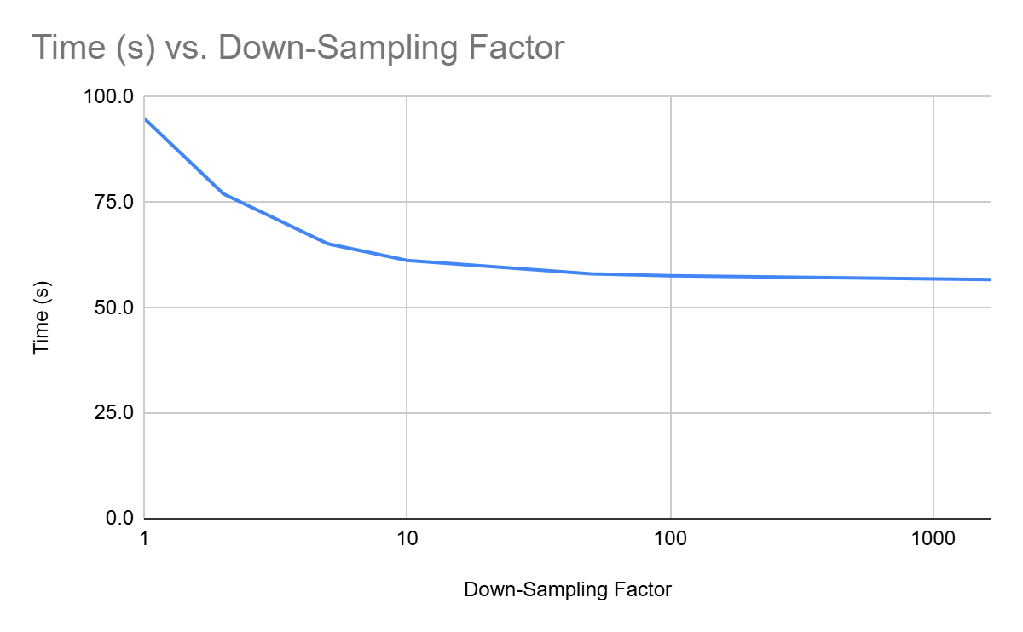
Performance Increase
Test was run for Roach 1 / Single pass.
Slice length before downsampling = 166700
Downsampling factor is equal to window width

